Slide 1
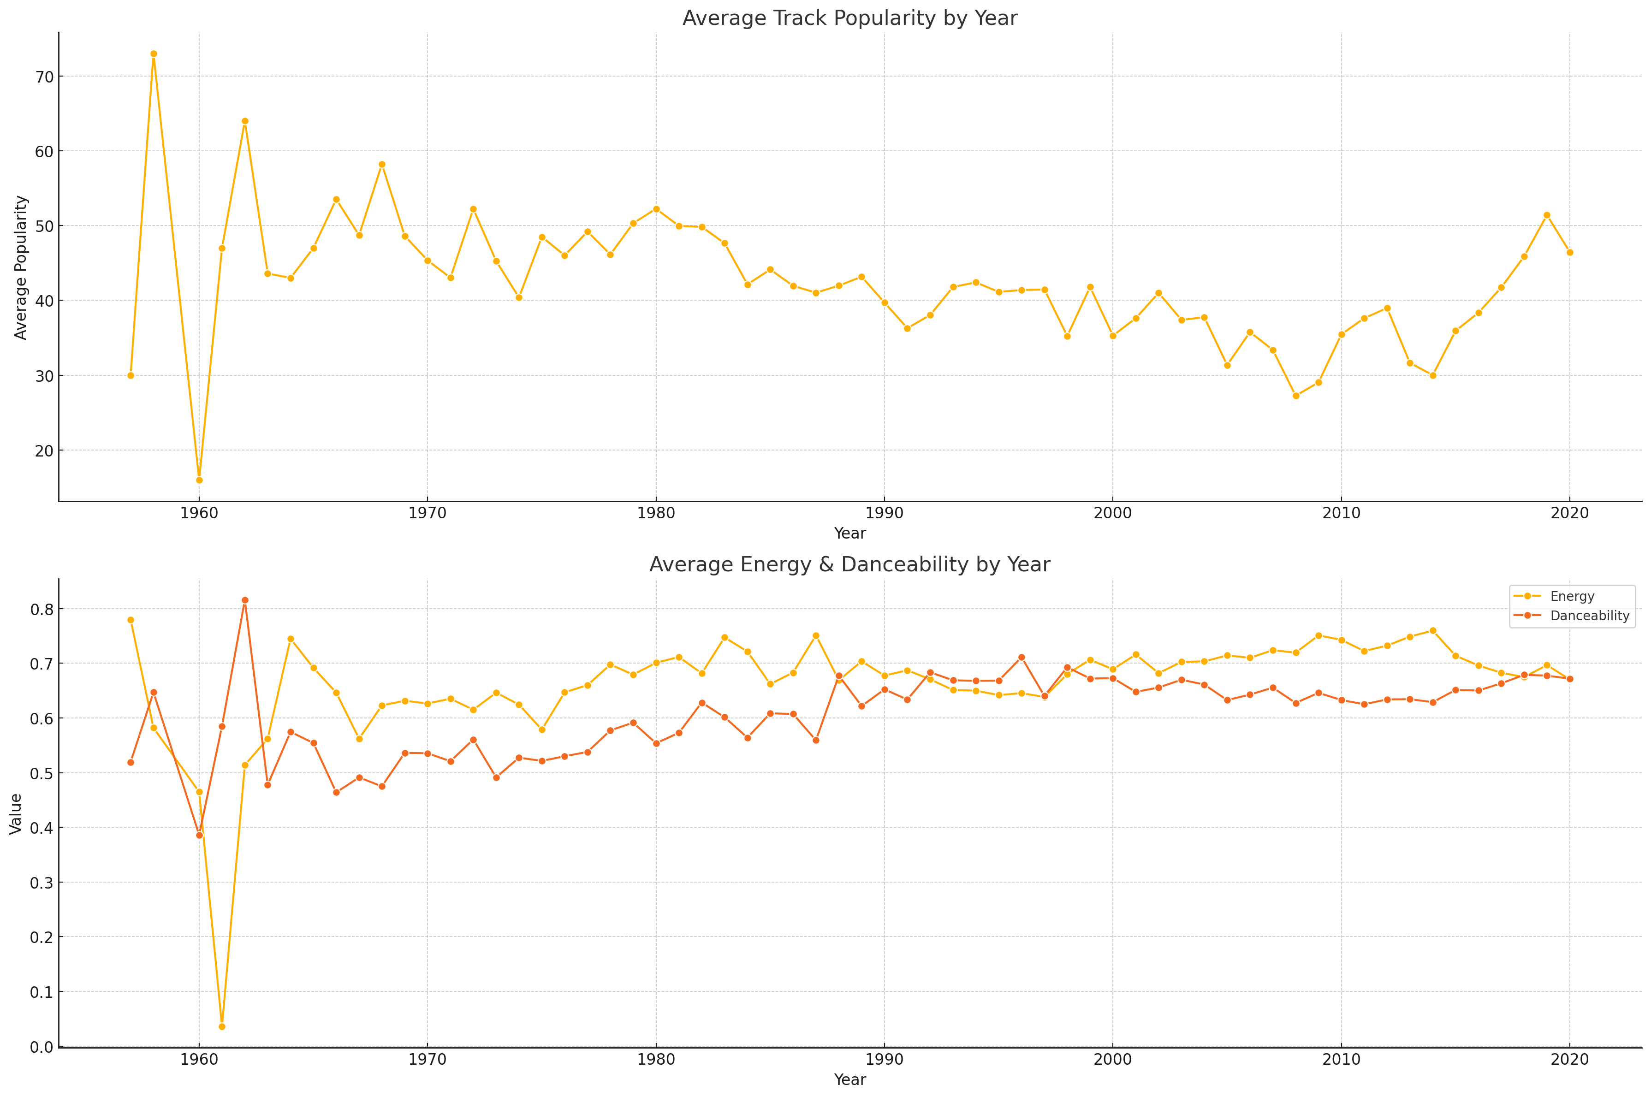

Slide 2

Evolving Popularity: Peaks & Trends in Top Artists' Music (2015-2019)
Key Insights:
• The chart highlights significant fluctuations in track popularity by year, with some artists peaking notably in specific years. • A discernible trend of increasing track popularity post-2015 across multiple artists suggests evolving listener preferences.

